Slide 1
Analysis of Chaotic Dynamical Systems
Igor Świerlikowski

Slide 2
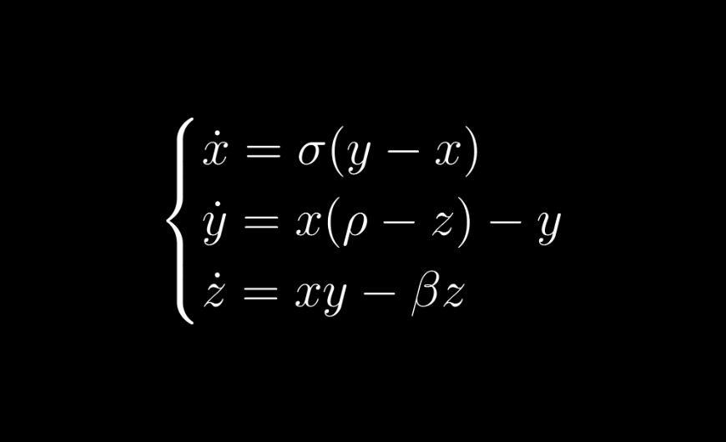
Dynamical Systems
Dynamical system refers to a system whose state evolves over time according to a set of rules that describe how its current state influences future states.

Slide 3
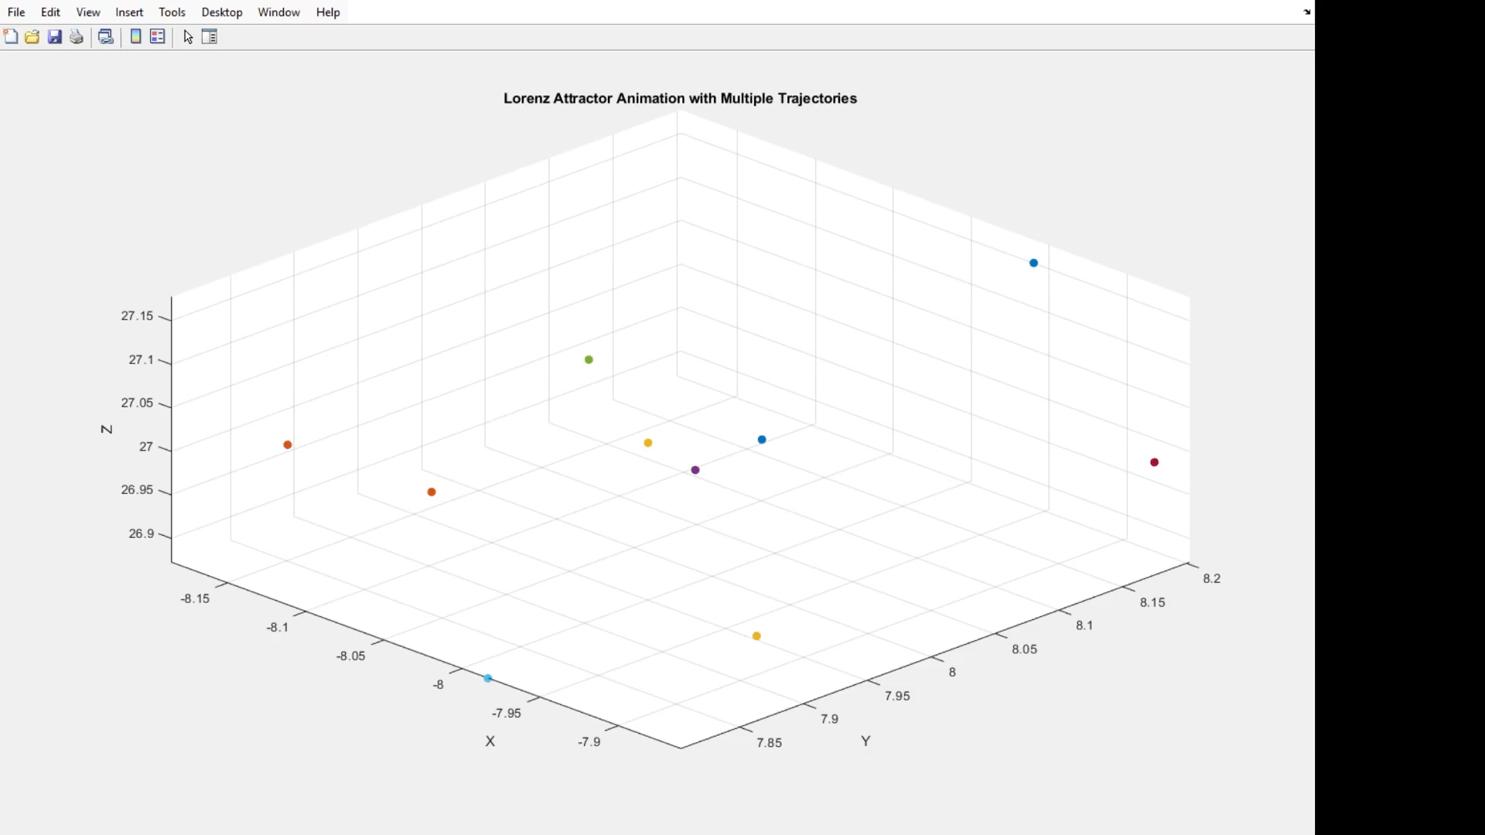
Chaotic Dynamical Systems

Slide 4
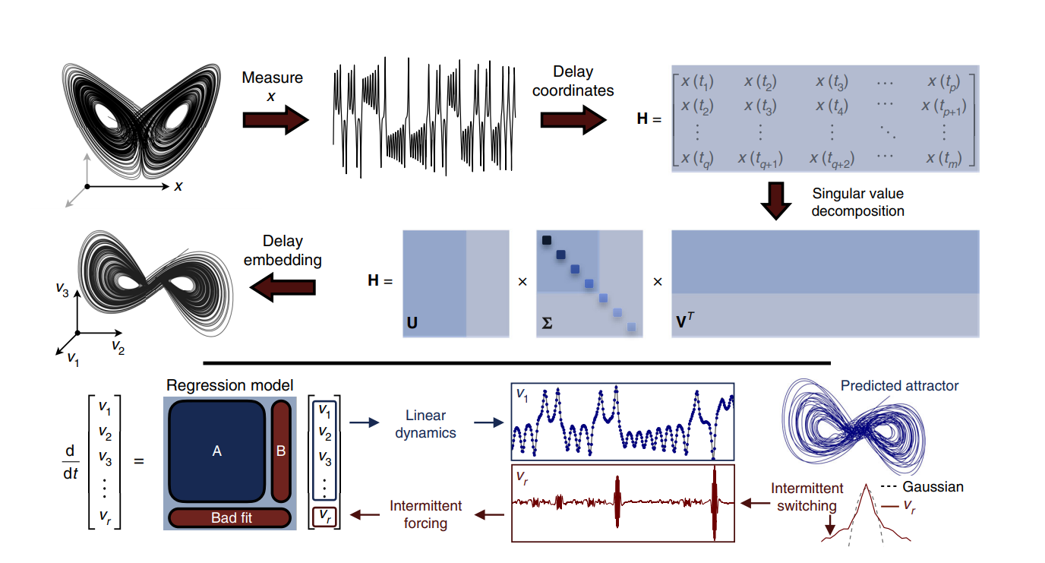
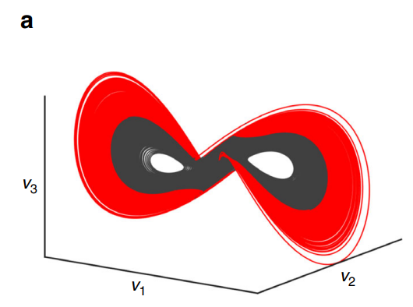
Hankel Alternative View of Koopman

Slide 5
My findings:

Slide 6
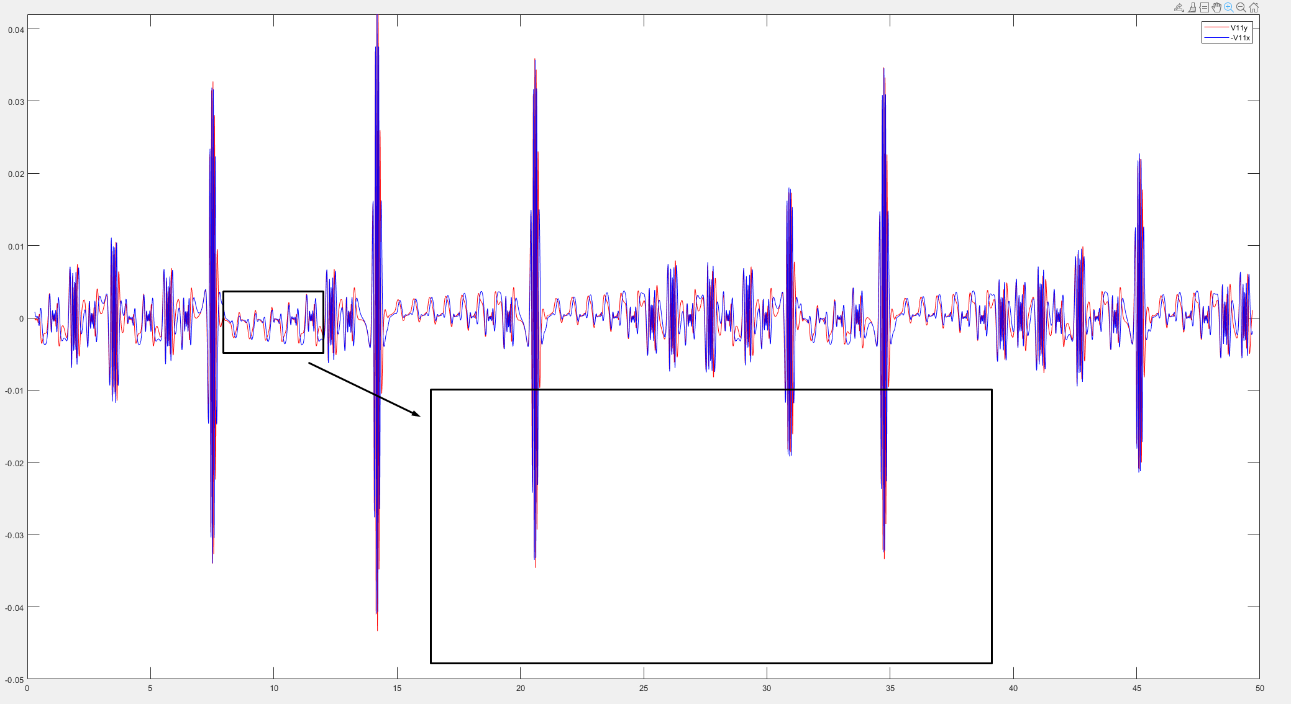
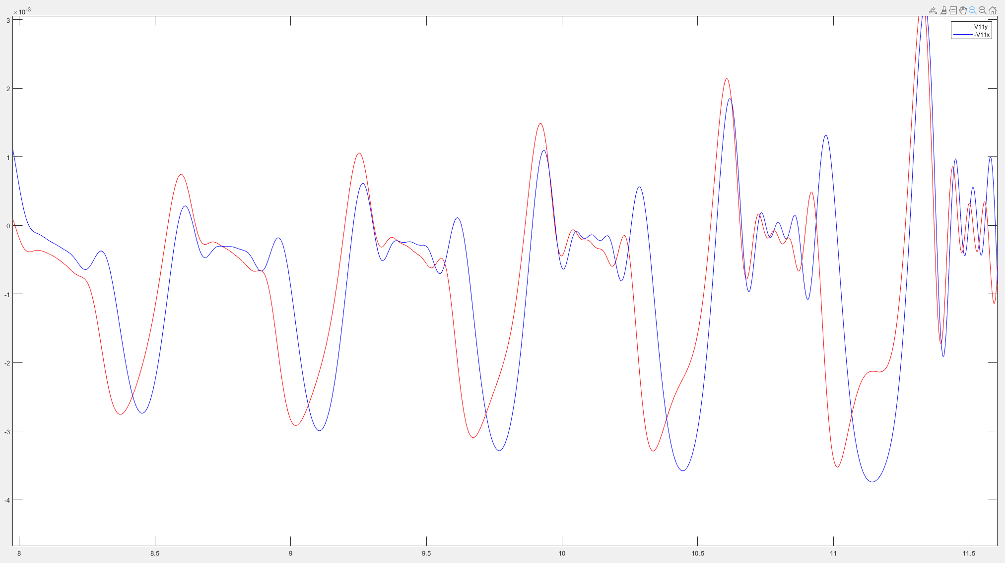
Predicting a variable with limited data

Slide 7
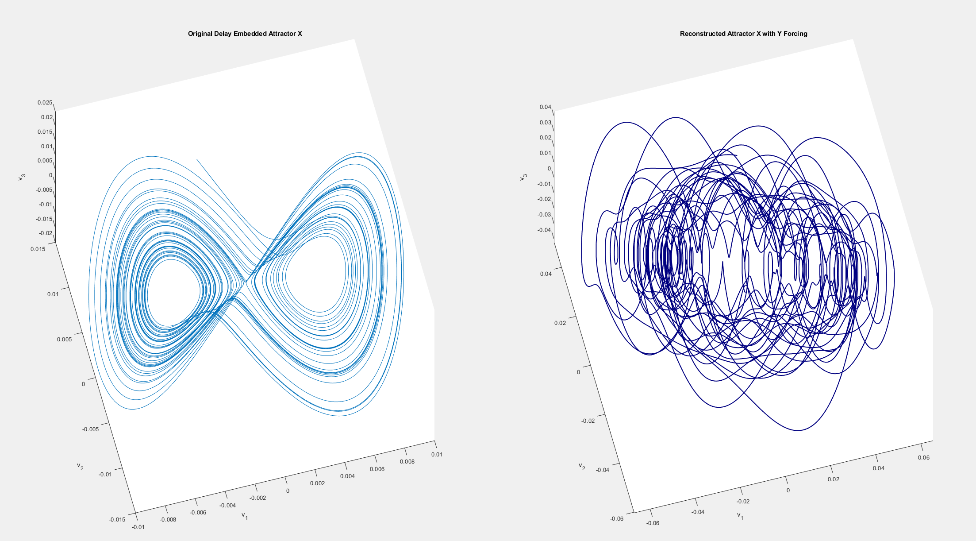
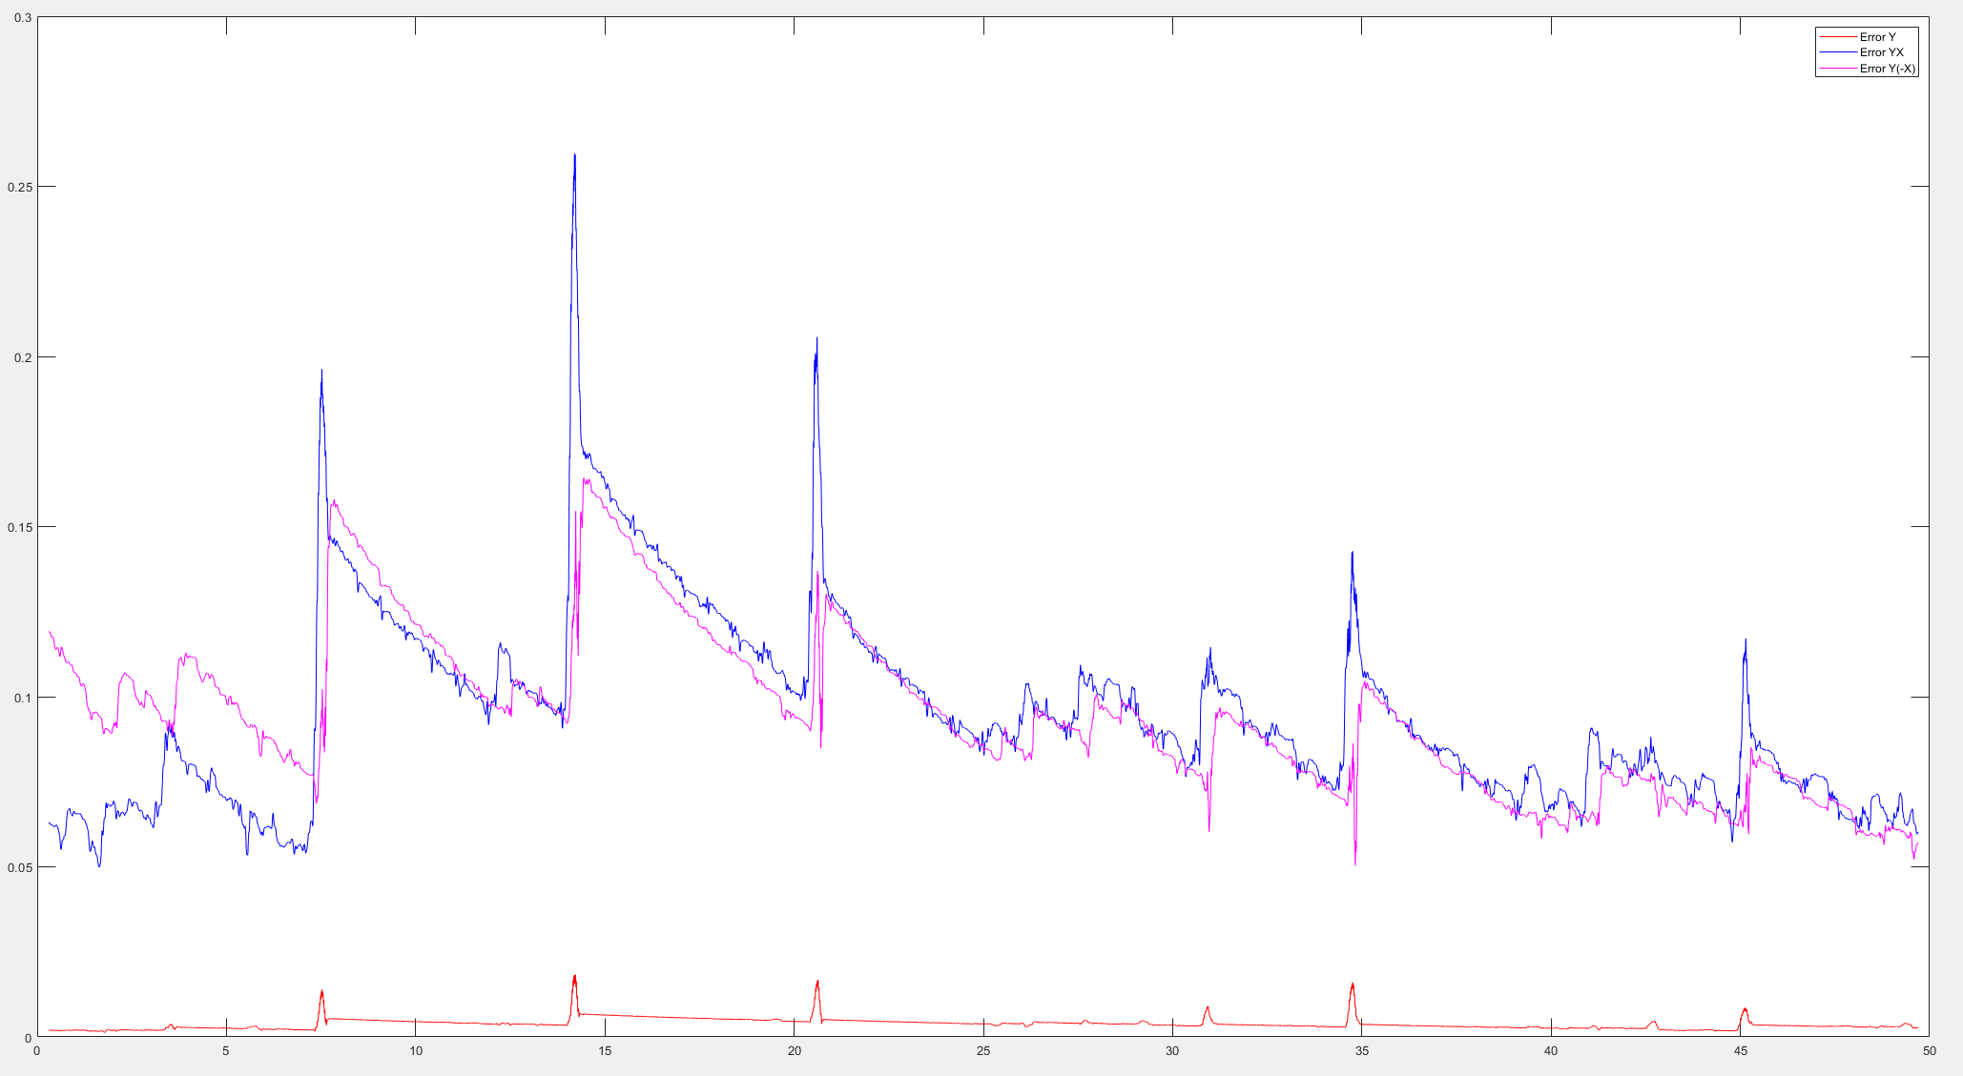
Results

Slide 8
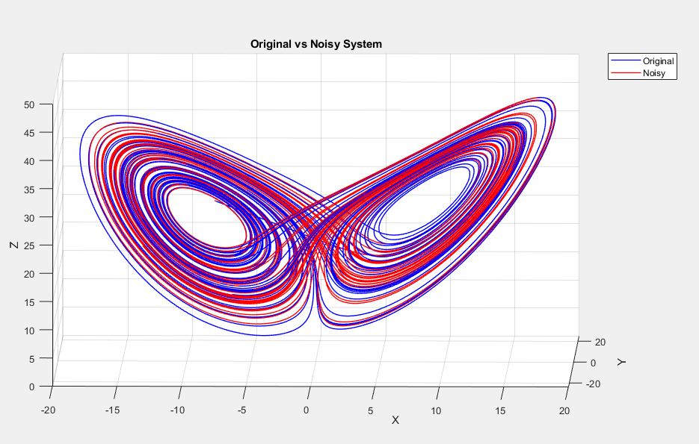
De-noising a chaotic system

Slide 9
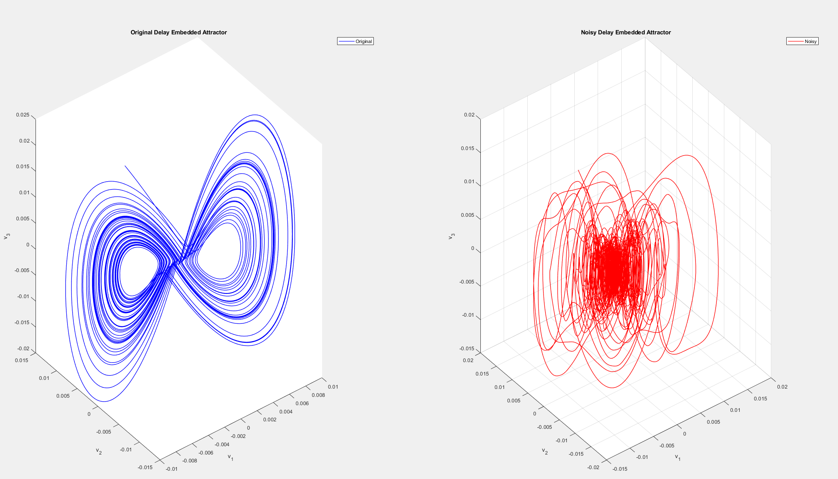
Reconstruction

Slide 10
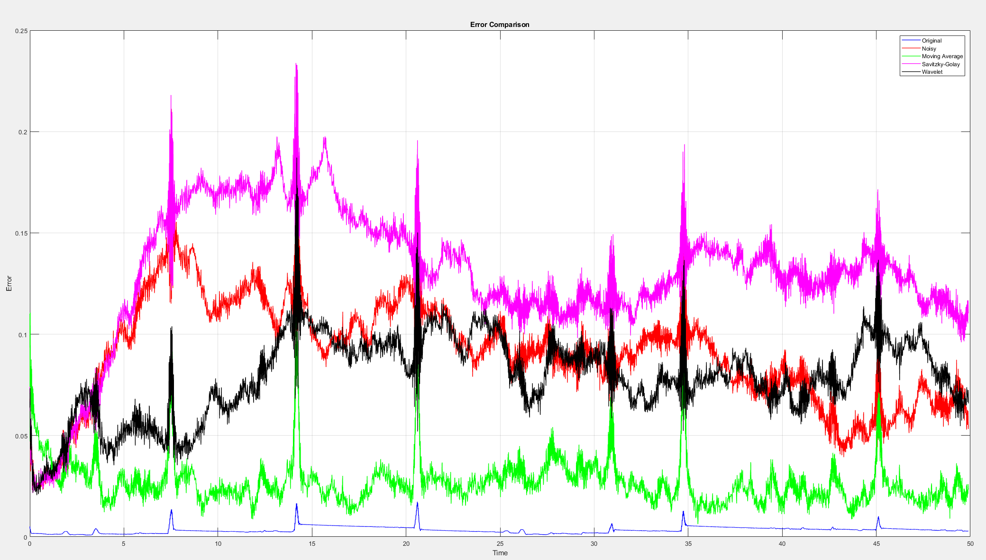
Results
Max Noise = 0.02

Slide 11
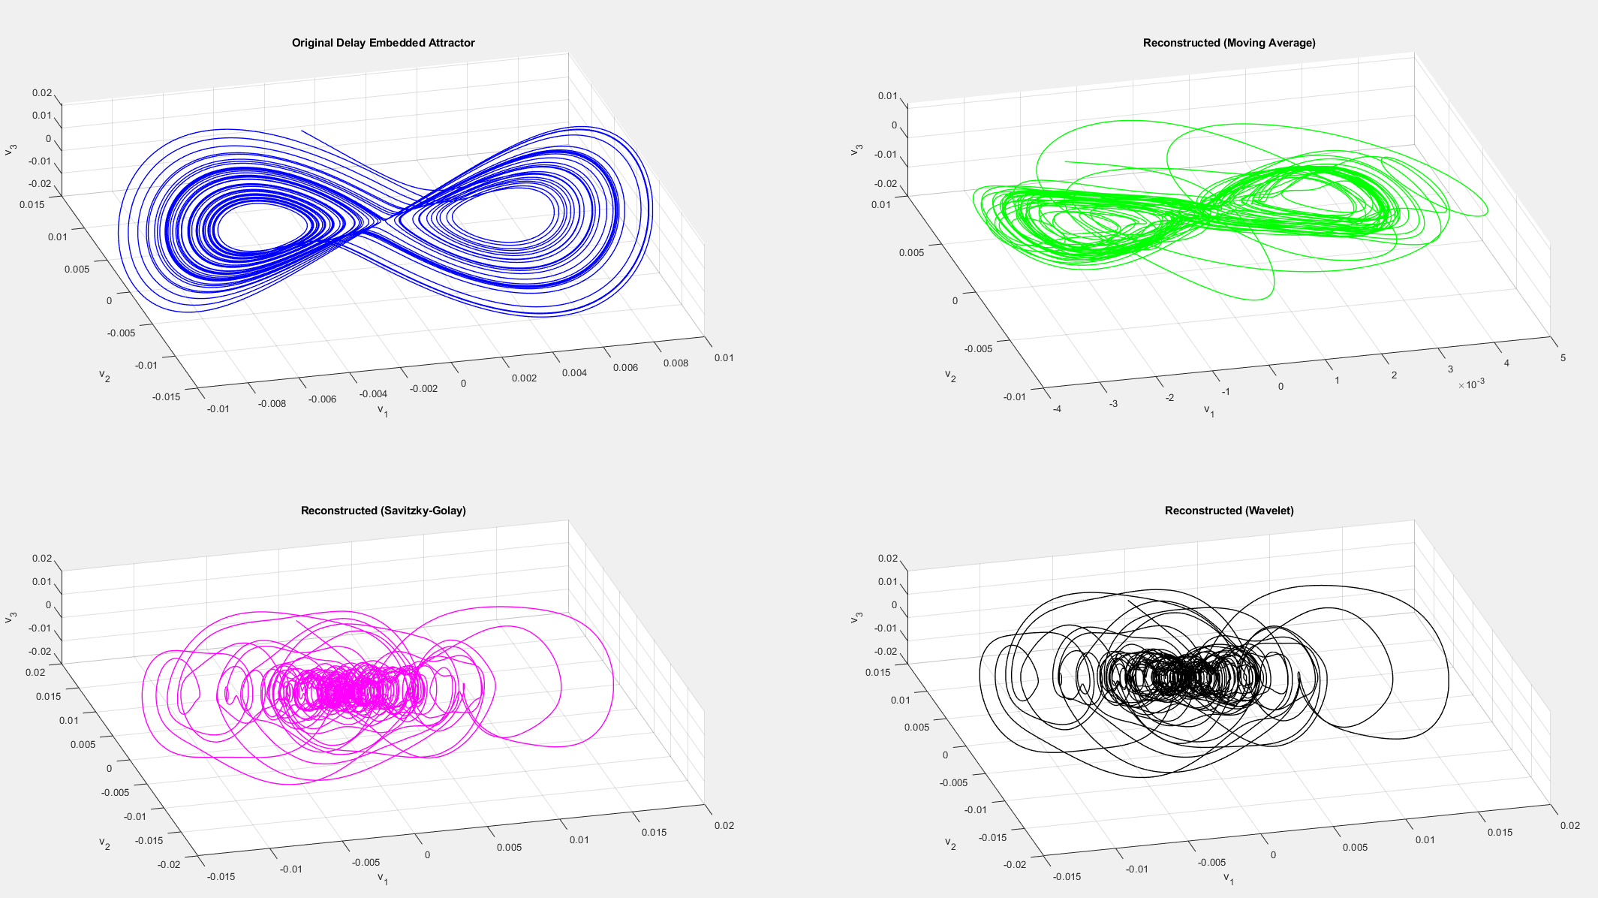
Results

Slide 12
Future Reasearch Plans:

Slide 13
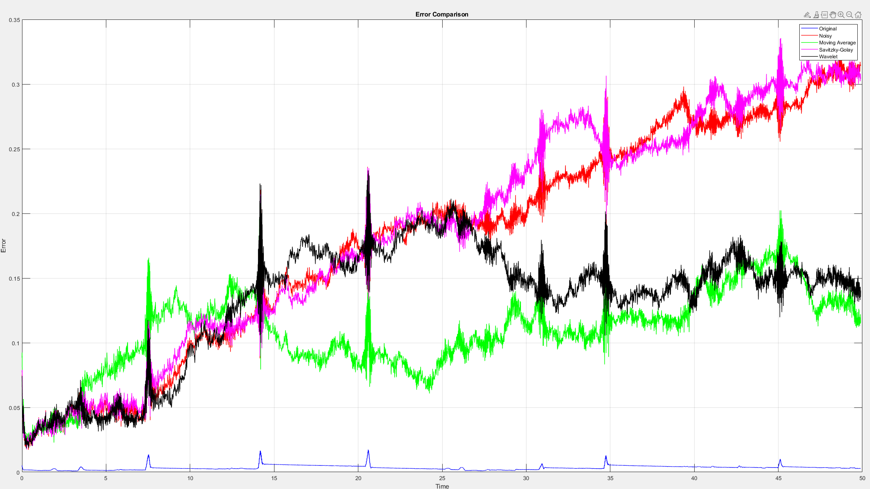
Continue Work On Denoising
Max Noise = 0.3

Slide 14
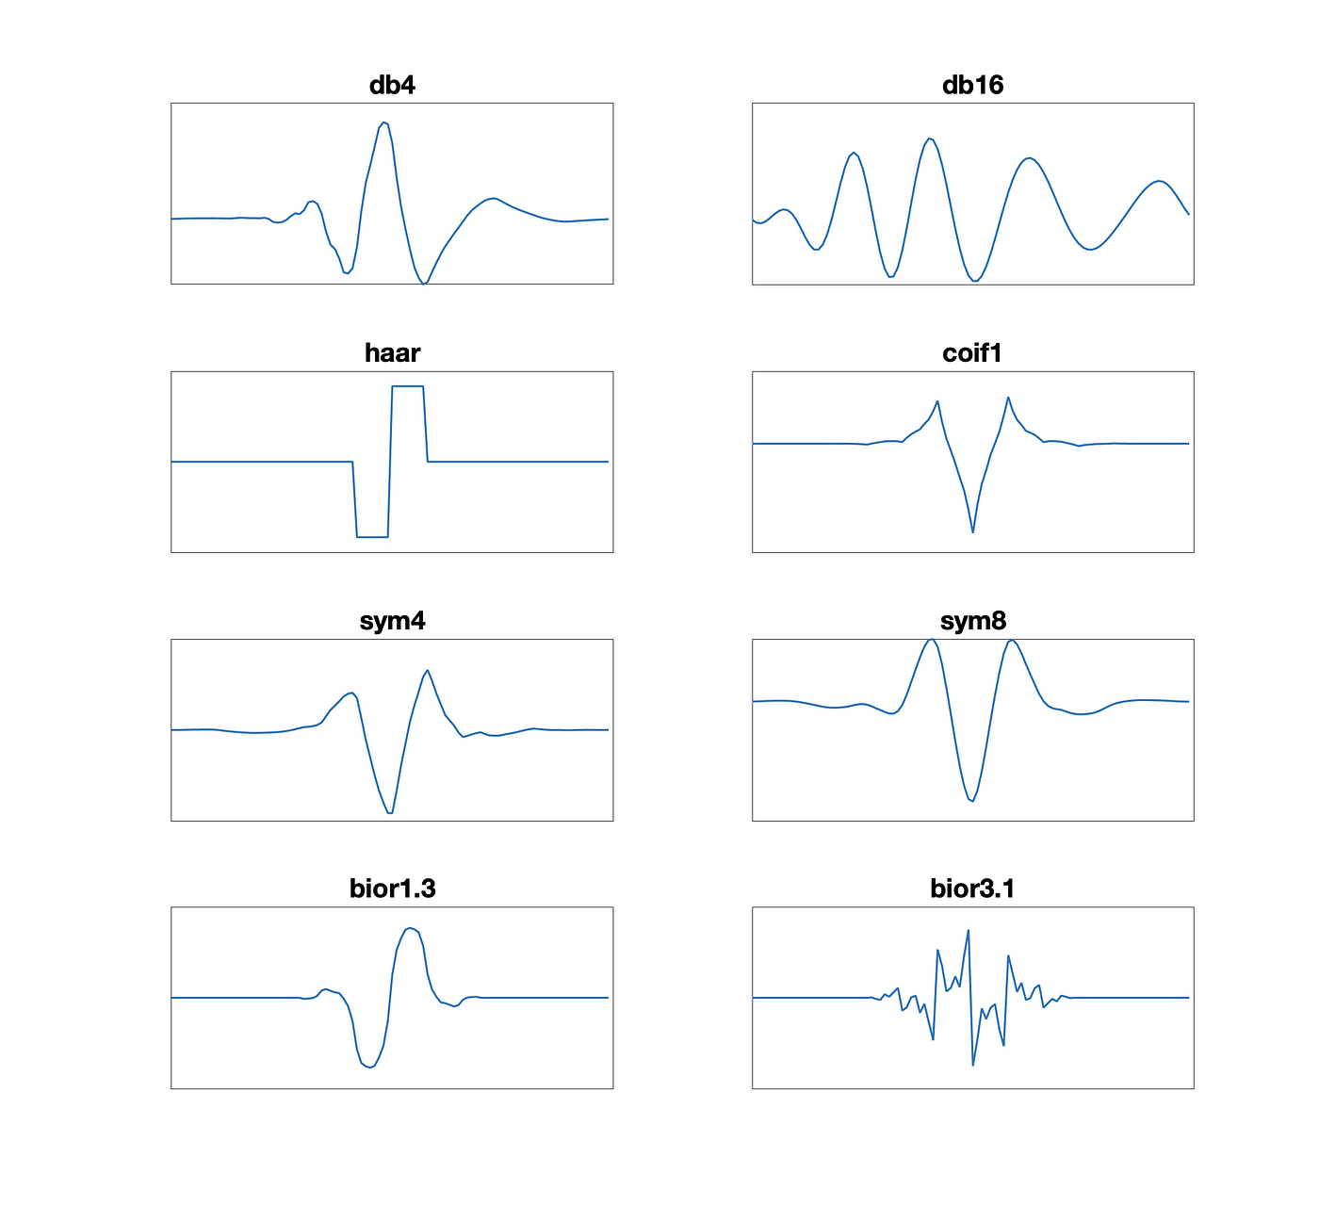
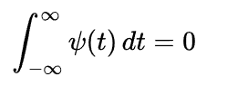
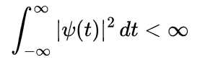
What are wavelets?
Admissibility Condition - 0 average
Finite Energy
Localization in time and frequency - compact support
Oscillatory Nature
Scalability and Translatability – dilating/compressing in time and shifting in time
Frequency Band-Pass Nature – captures information in a specific frequency band, determined by its scale

Slide 15
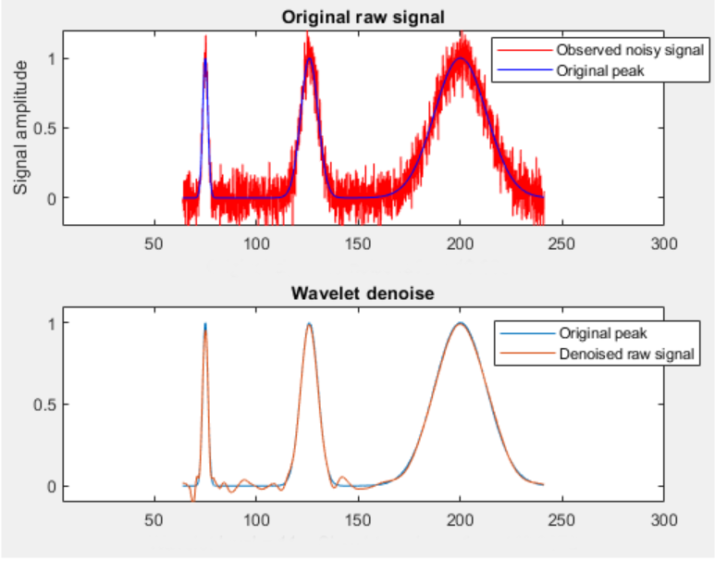
Wavelet Denoising

